Slide 1
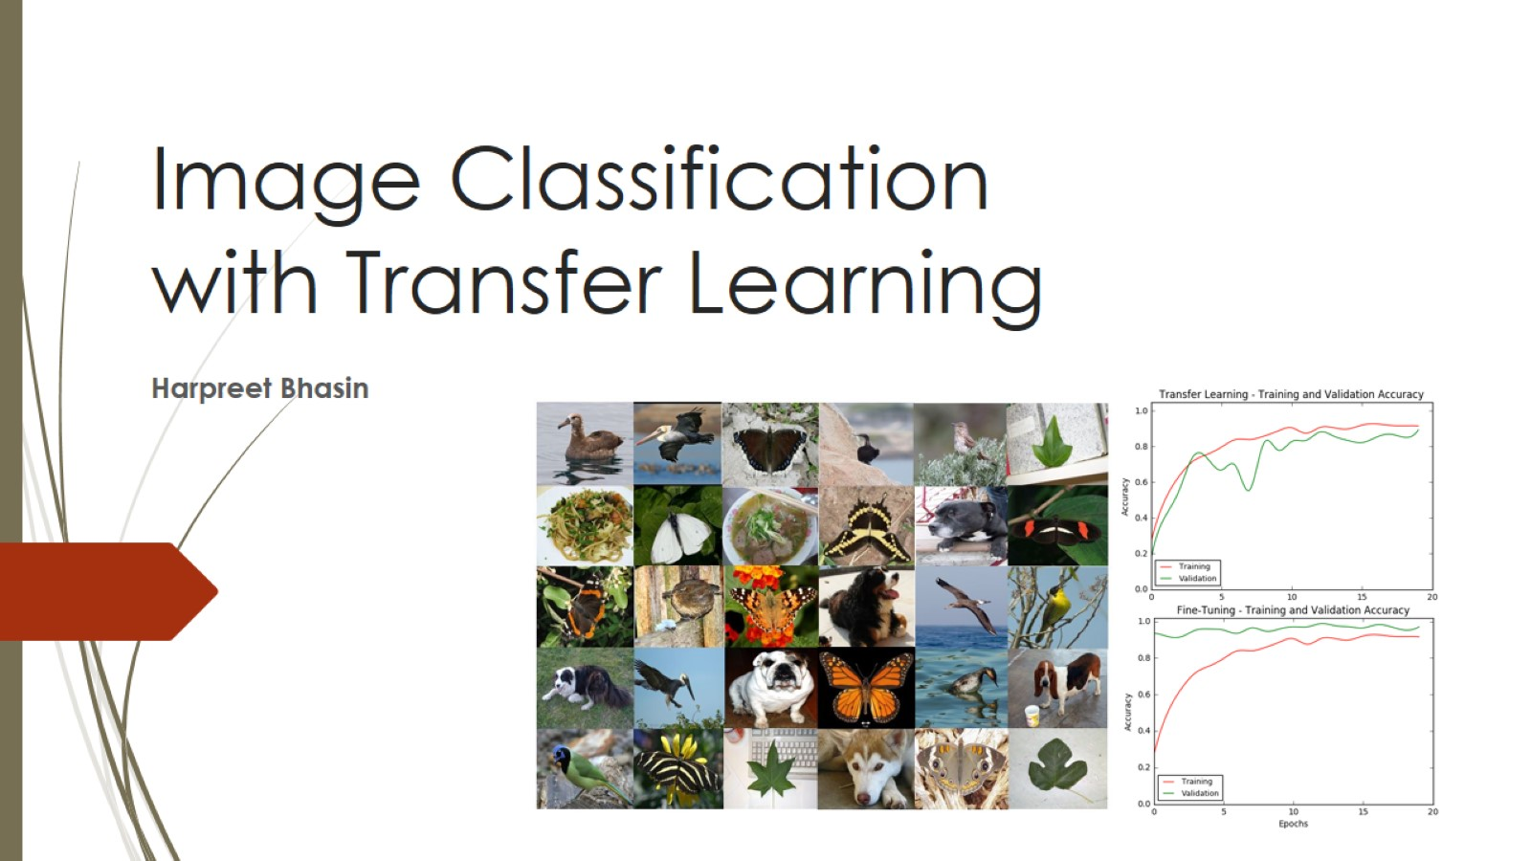
Image Classification with Transfer Learning

Slide 2
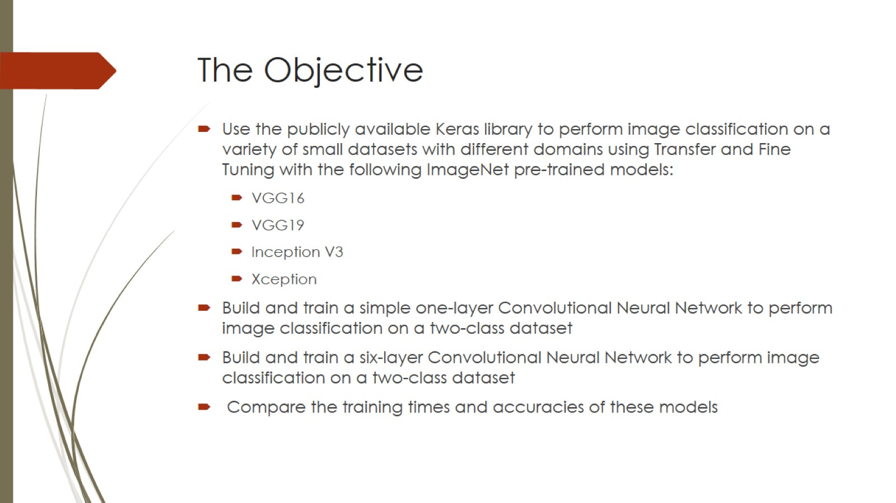
The Objective

Slide 3
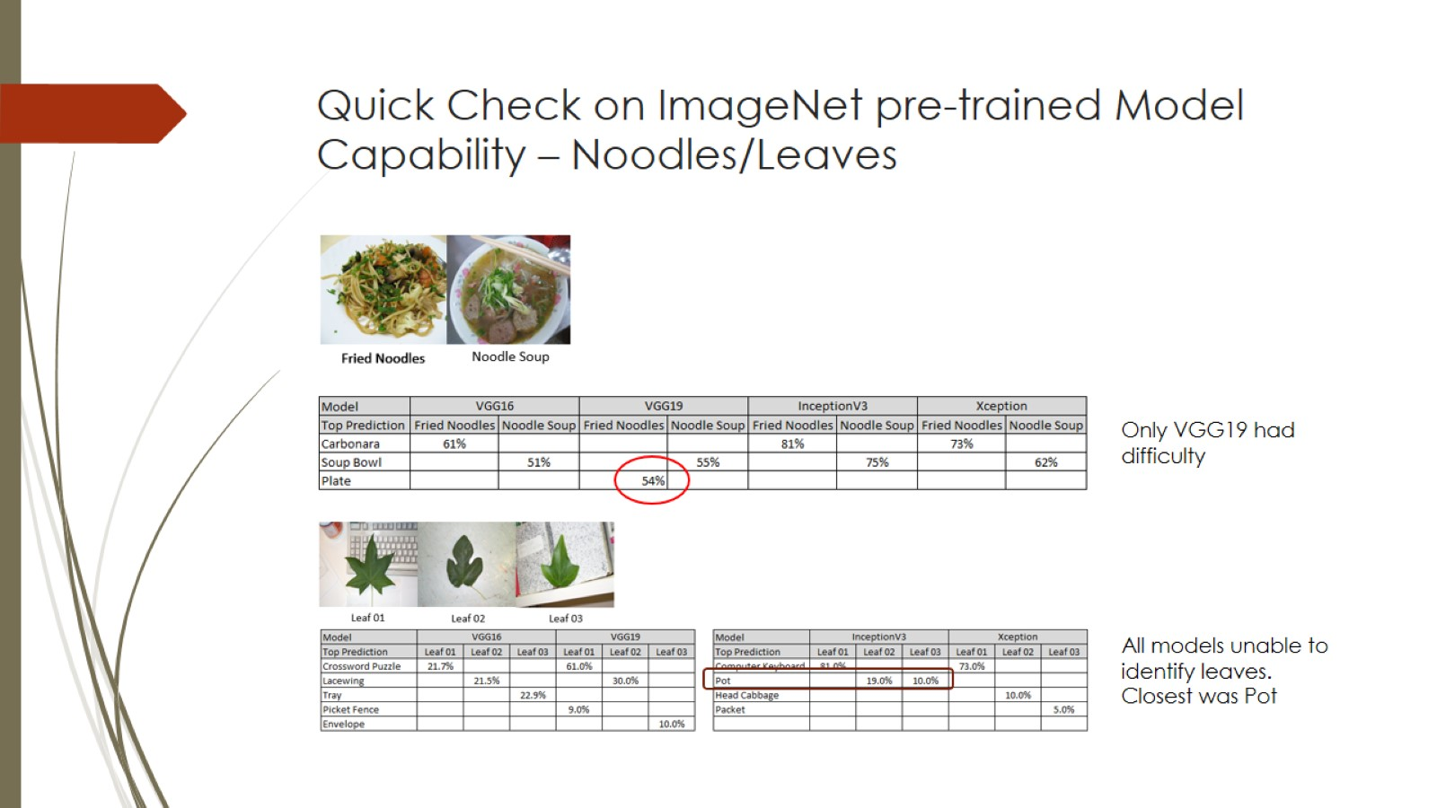
Quick Check on ImageNet pre-trained Model Capability – Noodles/Leaves

Slide 4
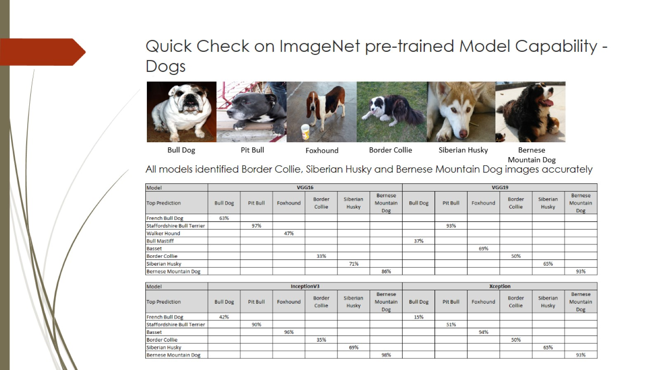
Quick Check on ImageNet pre-trained Model Capability - Dogs

Slide 5
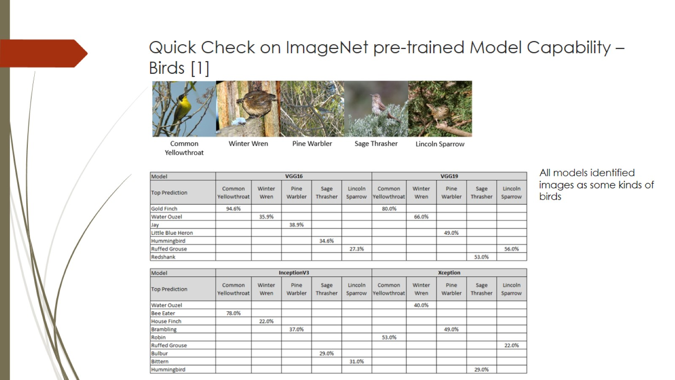
Quick Check on ImageNet pre-trained Model Capability – Birds [1]

Slide 6
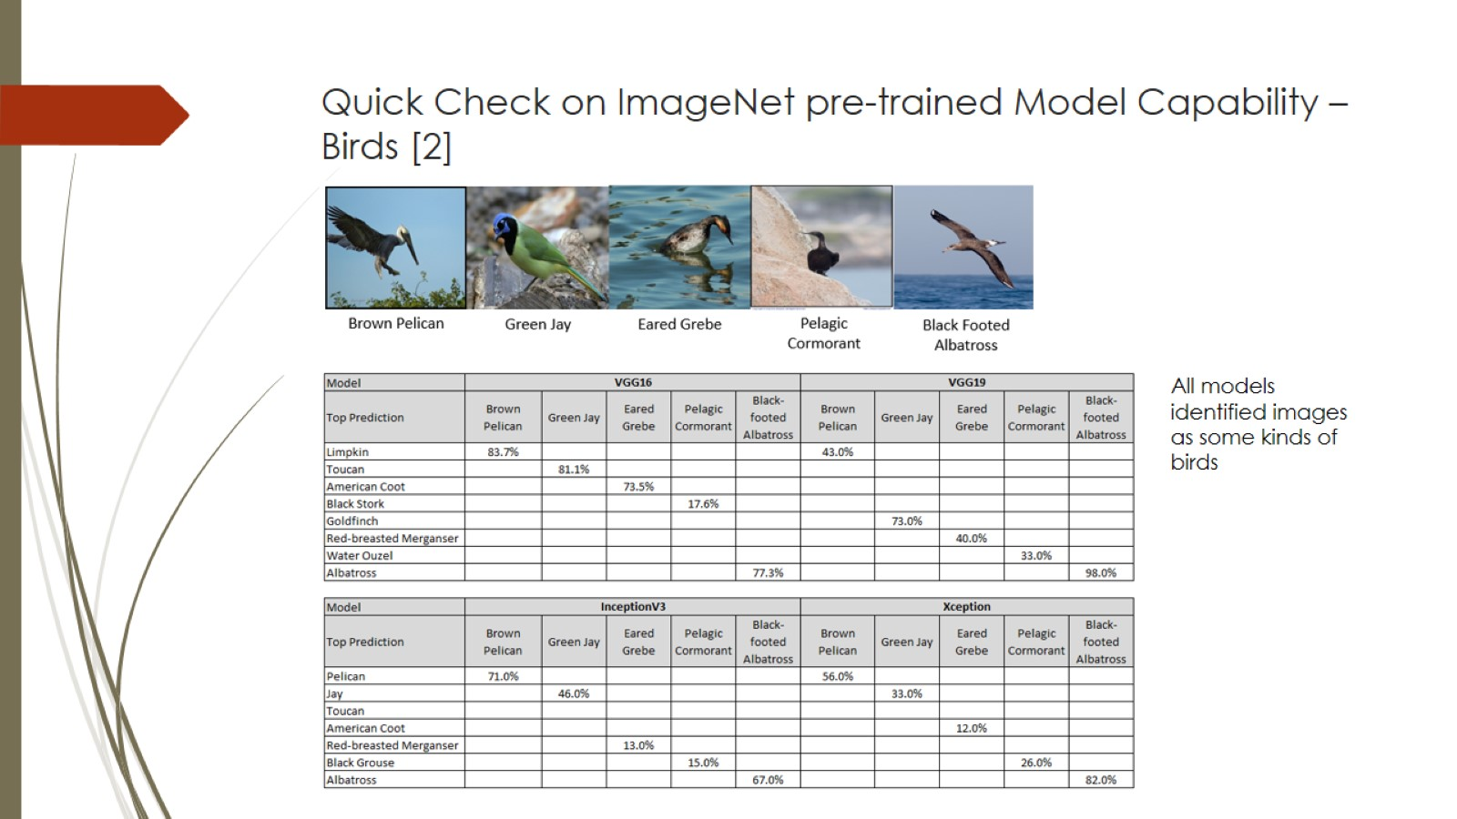
Quick Check on ImageNet pre-trained Model Capability – Birds [2]

Slide 7
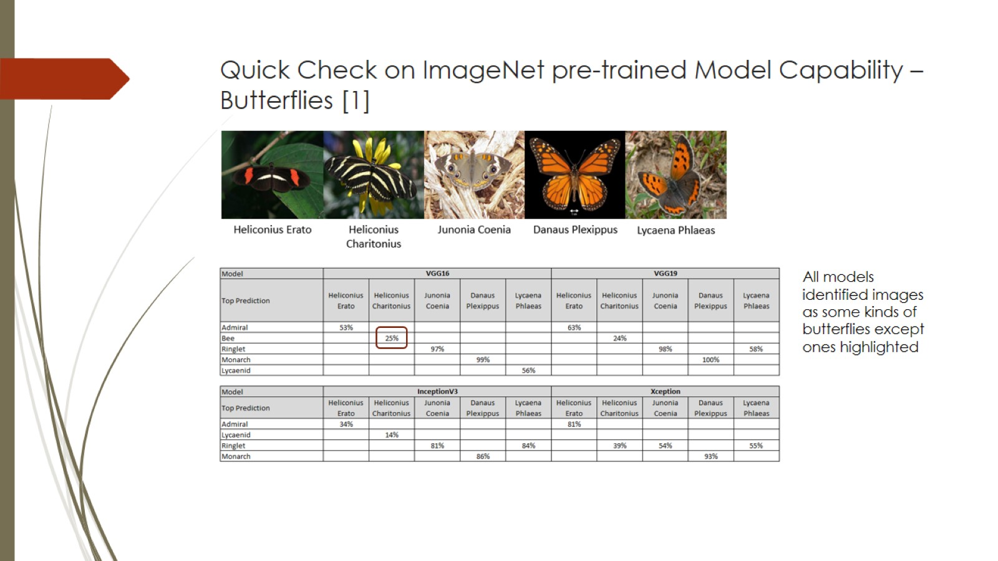
Quick Check on ImageNet pre-trained Model Capability – Butterflies [1]

Slide 8
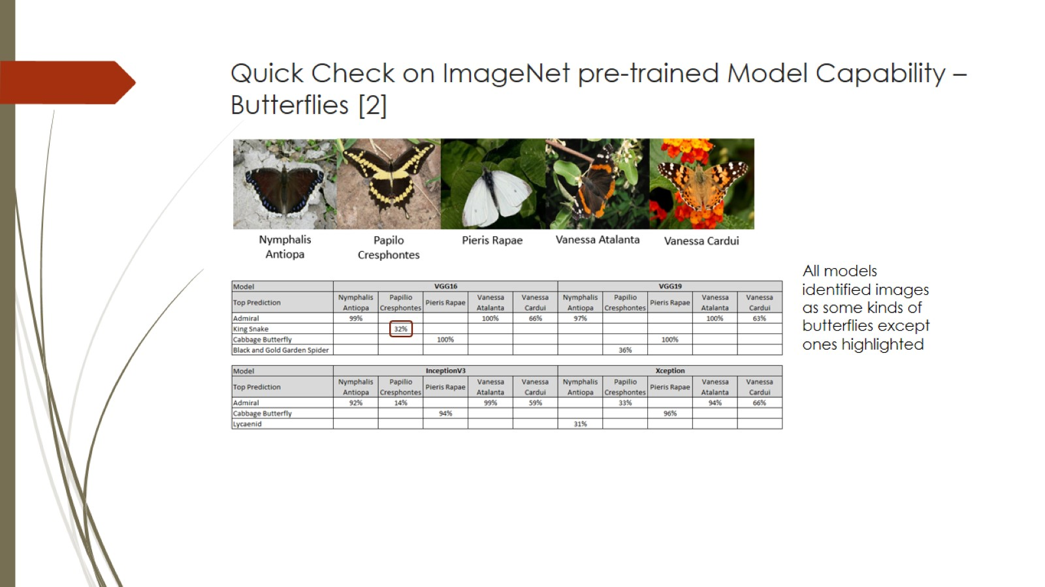
Quick Check on ImageNet pre-trained Model Capability – Butterflies [2]

Slide 9
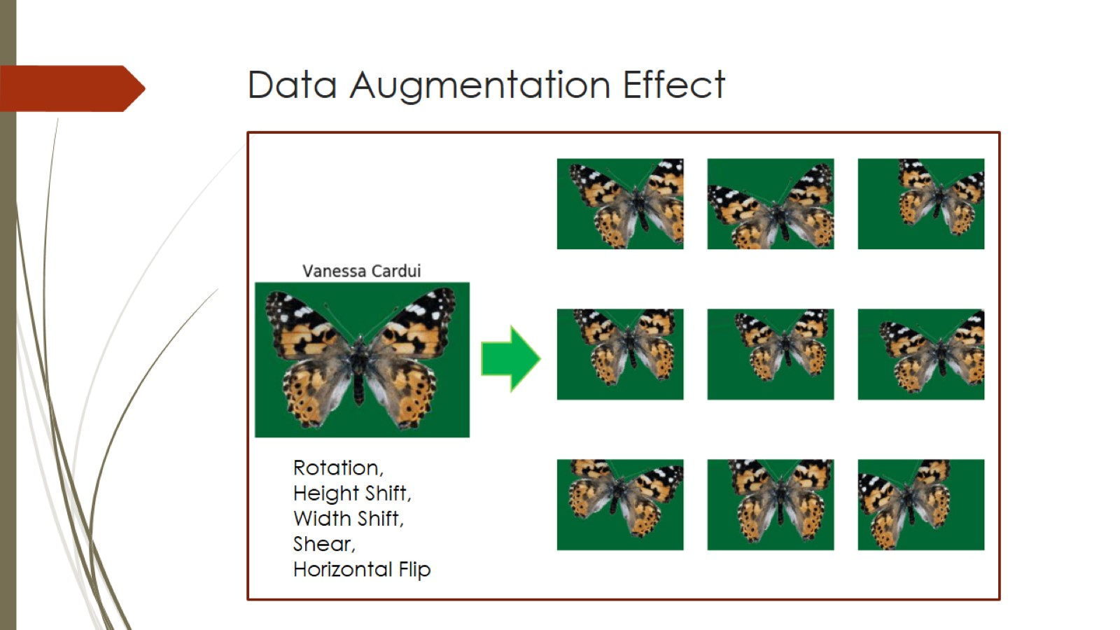
Data Augmentation Effect

Slide 10
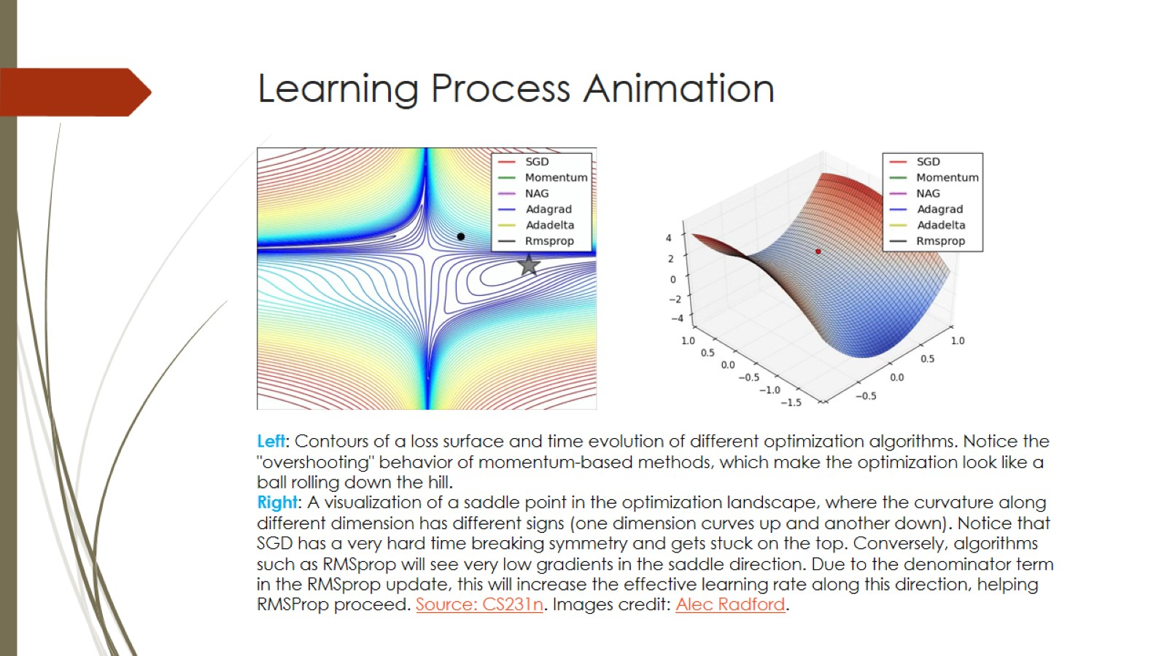
Learning Process Animation

Slide 11
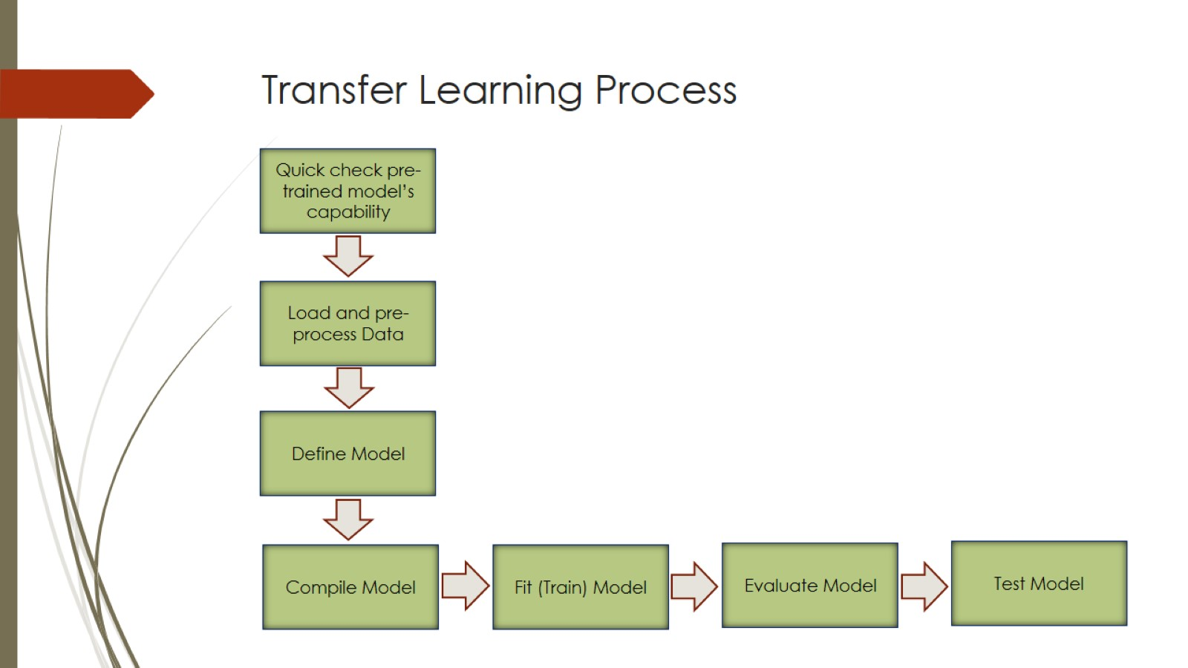
Transfer Learning Process

Slide 12
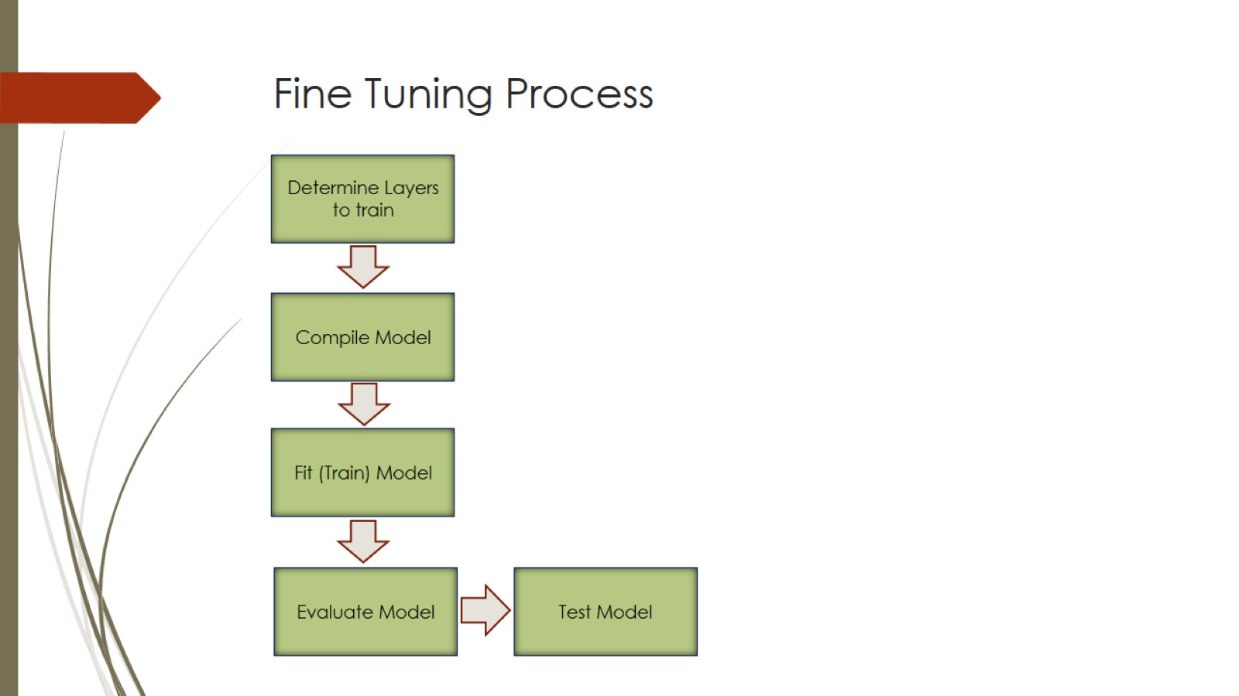
Fine Tuning Process

Slide 13
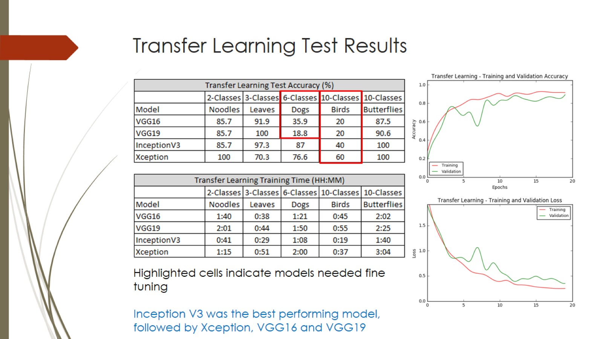
Transfer Learning Test Results

Slide 14
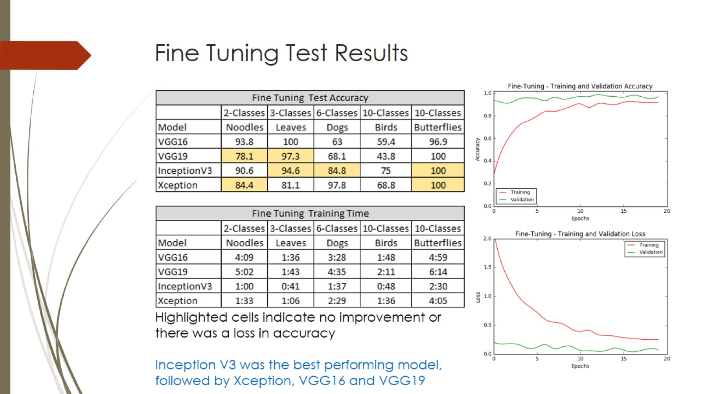
Fine Tuning Test Results

Slide 15
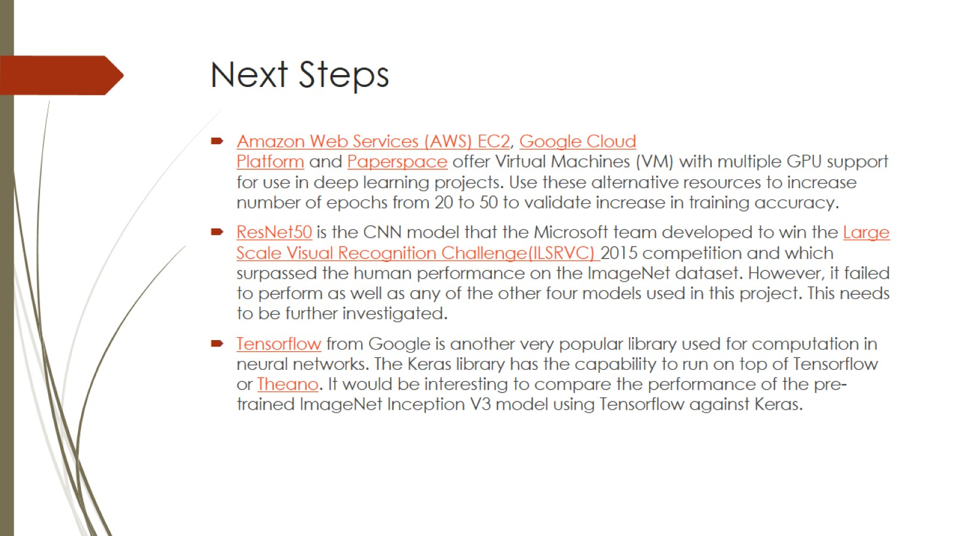
Next Steps

